Slide 1
MAMA Study
Michael & Tyler

Slide 2
Our Challenge
The minimum audible movement angle (MAMA) of a sound source varies as a function of the sound's frequency, bandwidth, angular location, elevation, and velocity [110--112]. However, it is generally agreed that as the velocity of a sound increases, the MAMA also increases. Accordingly, the proposed work will assess how movement speed affects performance for near-field and far field sounds in this real-world context.

Slide 3
Proposed Research
What rate of 3D sound movement can be reliably detected at near- and far-fields?

Slide 4
Hypothesis Statement
H₀: There is an ideal rate of 3-D sound movement to identify and localize near field sounds in VAE
H₀: There is an ideal rate of 3-D sound movement to identify and localize far field sounds in VAE
H_{A}: There is NOT an ideal rate of 3-D sound movement to identify and localize near field sounds in VAE
H_{A}: There is NOT an ideal rate of 3-D sound movement to identify and localize far field sounds in VAE

Slide 5
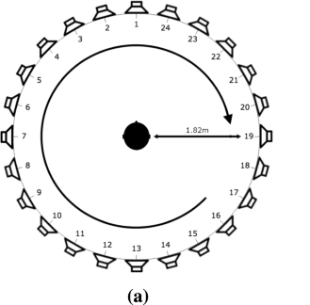
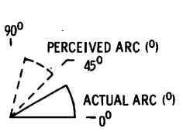
Minimum Audible Movement Angle
Minimum Audible Movement Angle (MAMA): The minimum angle of sound movement that can be distinguished.
Outside of distinguishing whether or or not a sound has moved, it’s important to know if the starting and ending position were perceived accurately.

Slide 6
Prior Research
It is generally agreed upon that “as the velocity of a sound increases, the MAMA also increases”.
Localization for a tonal stimulus is most optimal at frequencies below 1000 Hz and above 3000-4000 Hz (Perrot & Tucker, 1988)
We gained more insight into moving sound perception through the studies of Han & Chen (2019) and Perrot & Musicant (1977).

Slide 7
Prior Research
Han & Chen (2019)
Created moving sounds in a virtual environment using an HRTF (Head Related Transfer Function) at different angular speeds. Tested if the motion could be perceived at different speeds.
Didn’t consider:
How reliably the participants could locate a position
Low angular velocities (they only did 100°/s, 150°/s, 200°/s).
In a situation where accuracy is very important, it’s critical that we know how lower angular speeds affect perception of virtually created 3-D sound. This insight might allow us to create sounds movement that’s audible and reliable.
Perrot & Musicant (1977)
Measured the localization accuracy of moving sounds by playing noise from a speaker on a moving pole.
Participants' view was obstructed by a sheet with degrees printed in the azimuth plane.
They were told to report where the sound started and ended.

Slide 8
Study Design
Experiment Type: Within-groups Study (Repeated Measures)
Sound Source: A moving object (a triangle wave at 400Hz) starting somewhere in front of the participant and moving left or right for a duration of 500ms while white noise plays in the background.
Localization task: Participants will need to identify the starting (onset angle) and ending position (offset angle) of the sound source

Slide 9
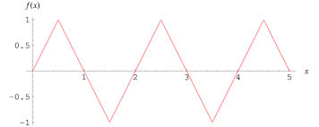
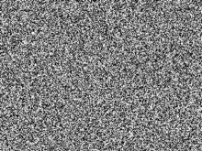
Source Signal Chain
Triangle wave at 400HZ
White Noise
+
HRTF
Distance Filter

Slide 10
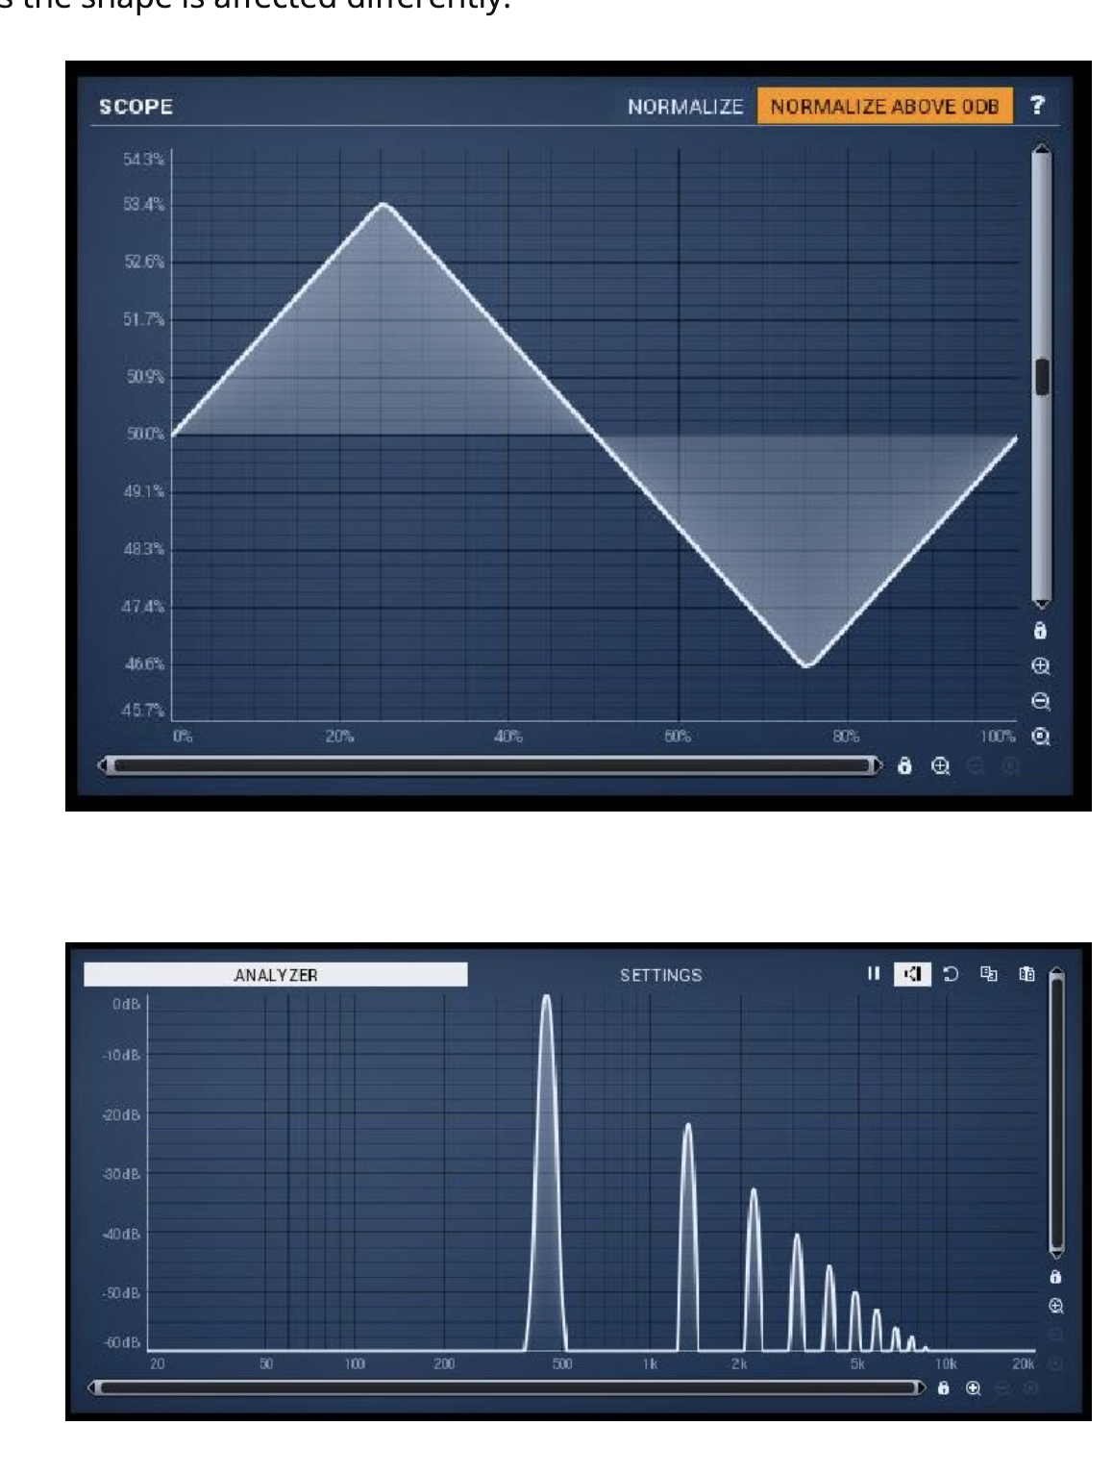
Why a triangle wave?
To mitigate the effects of the critical bands while preserving the impact of the distance filter, we chose a triangle wave as our sound source. It allows us to keep our fundamental frequency below 1000Hz while minimizing the MAMA error other studies observed above 1kHz. This way, when we filter for far-field sounds, it still sounds like the sound is far away.

Slide 11
Near-Field vs. Far-Field sounds
Since HRTFs don’t account for distance, we need to simulate that ourselves.
Near field sounds are simulated to sound less than 1m away from the participant. We’ll create them by exaggerating the cues of the IID as shown by Brungart (1999).
Far field sounds are simulated to sound more than 15m away from the participant. We’ll create them using a low pass filter, simulating the filtering due due to loss of high frequency energy in the air. We’ll play the sound with a gain reduction of -20dB to account for the inverse square law.
Notes:
https://pubs.aip.org/asa/jasa/article/106/6/3589/915945/Auditory-localization-of-nearby-sources-III

Slide 12
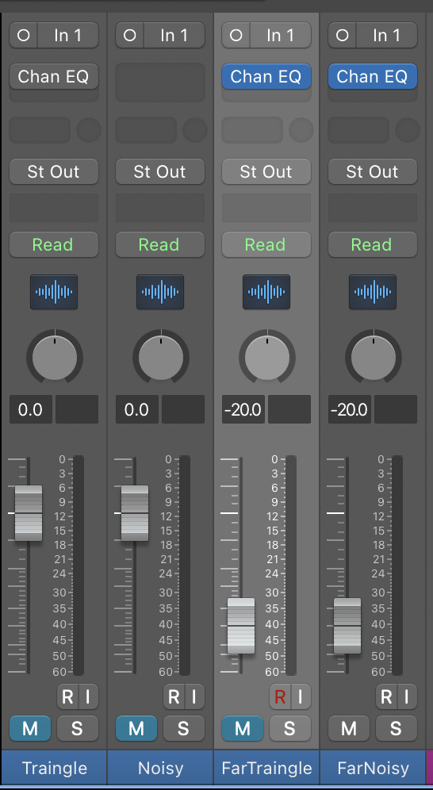
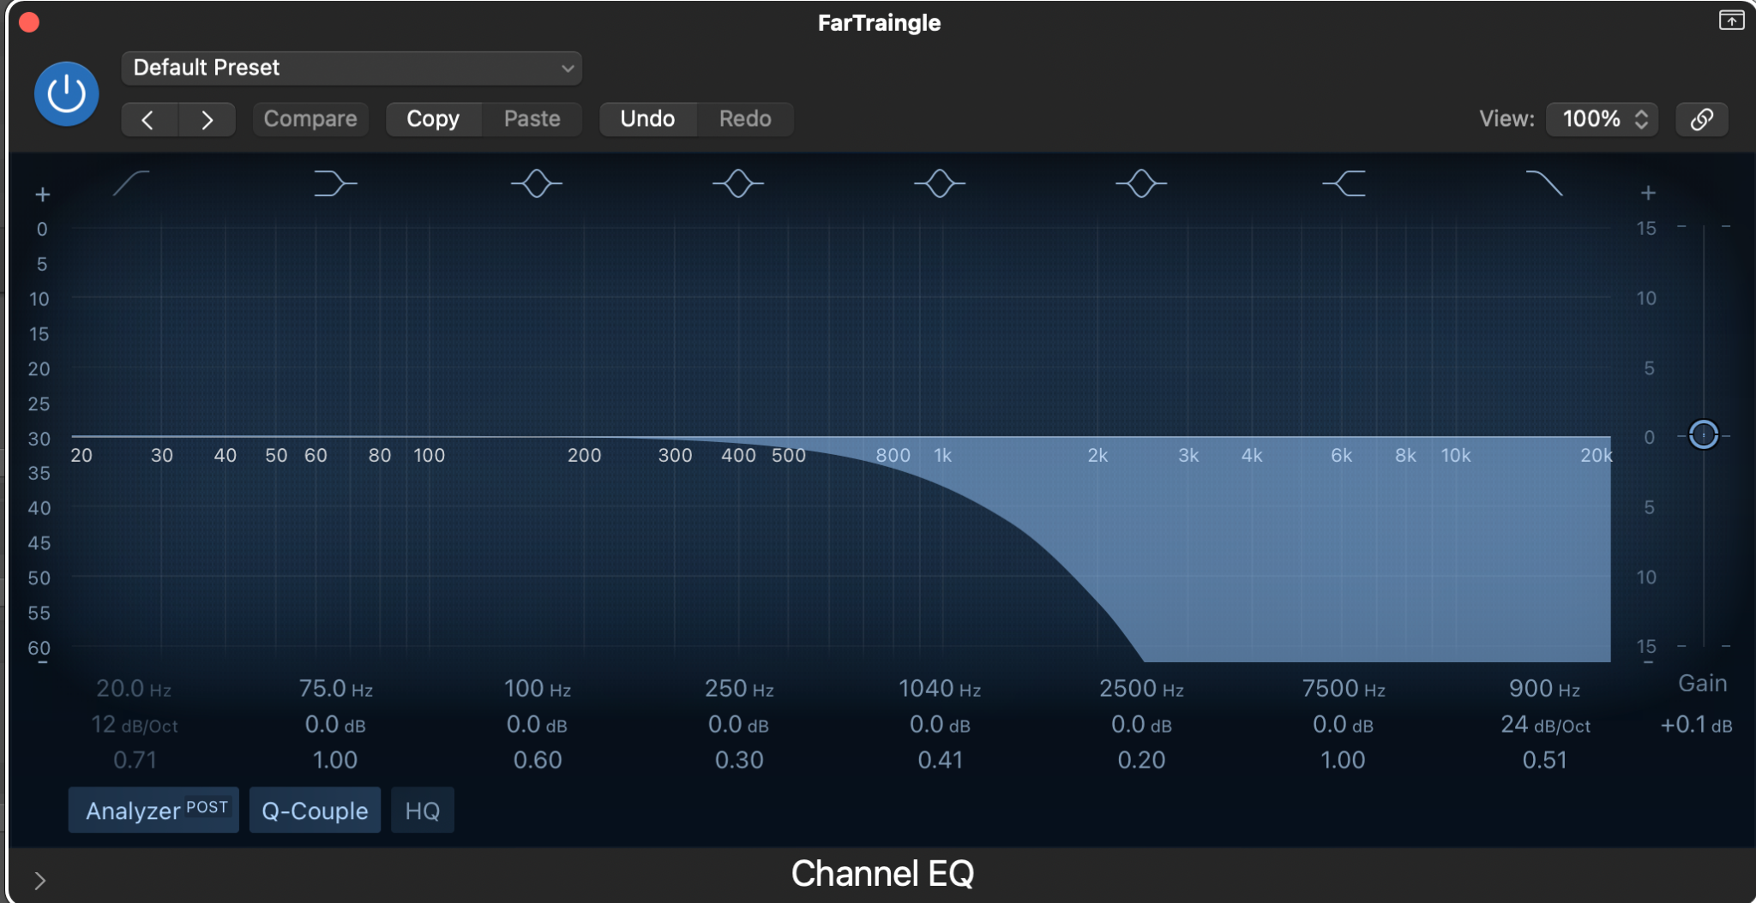
Far-Field Filter
-20dB in gain
Low pass filter at 900Hz with a rate of 24 dB/Oct and a Q factor of 0.51

Slide 13
Study Conditions (Factorial Design)
With this study design, all possible combinations of angular speeds, signal to noise ratios, and near/far field position will be explored. In Han & Chen’s study, there were 18 conditions matching 6 frequencies with 3 angular speeds. Since we are investigating the MAMA at differing speeds in near/far-field space, the frequency of the audio should remain constant, as the MAMA varies as a function of both velocity and frequency.

Slide 14
Variables we’re manipulating
145 possible testing conditions
1 static condition 0 degrees with duration of 500ms
6 movement speeds (10°/s, 20°/s, 40°/s, 80°/s, 160°/s, and 320°/s)
2 distances (near field and far field)
2 noise ratios (0%, 50%)
6 possibilities for angular movement ( 5°, 20°, 40°, 60°, 90°, 120°)

Slide 15
Constants
1 constant
Input source of a 400Hz triangle wave

Slide 16
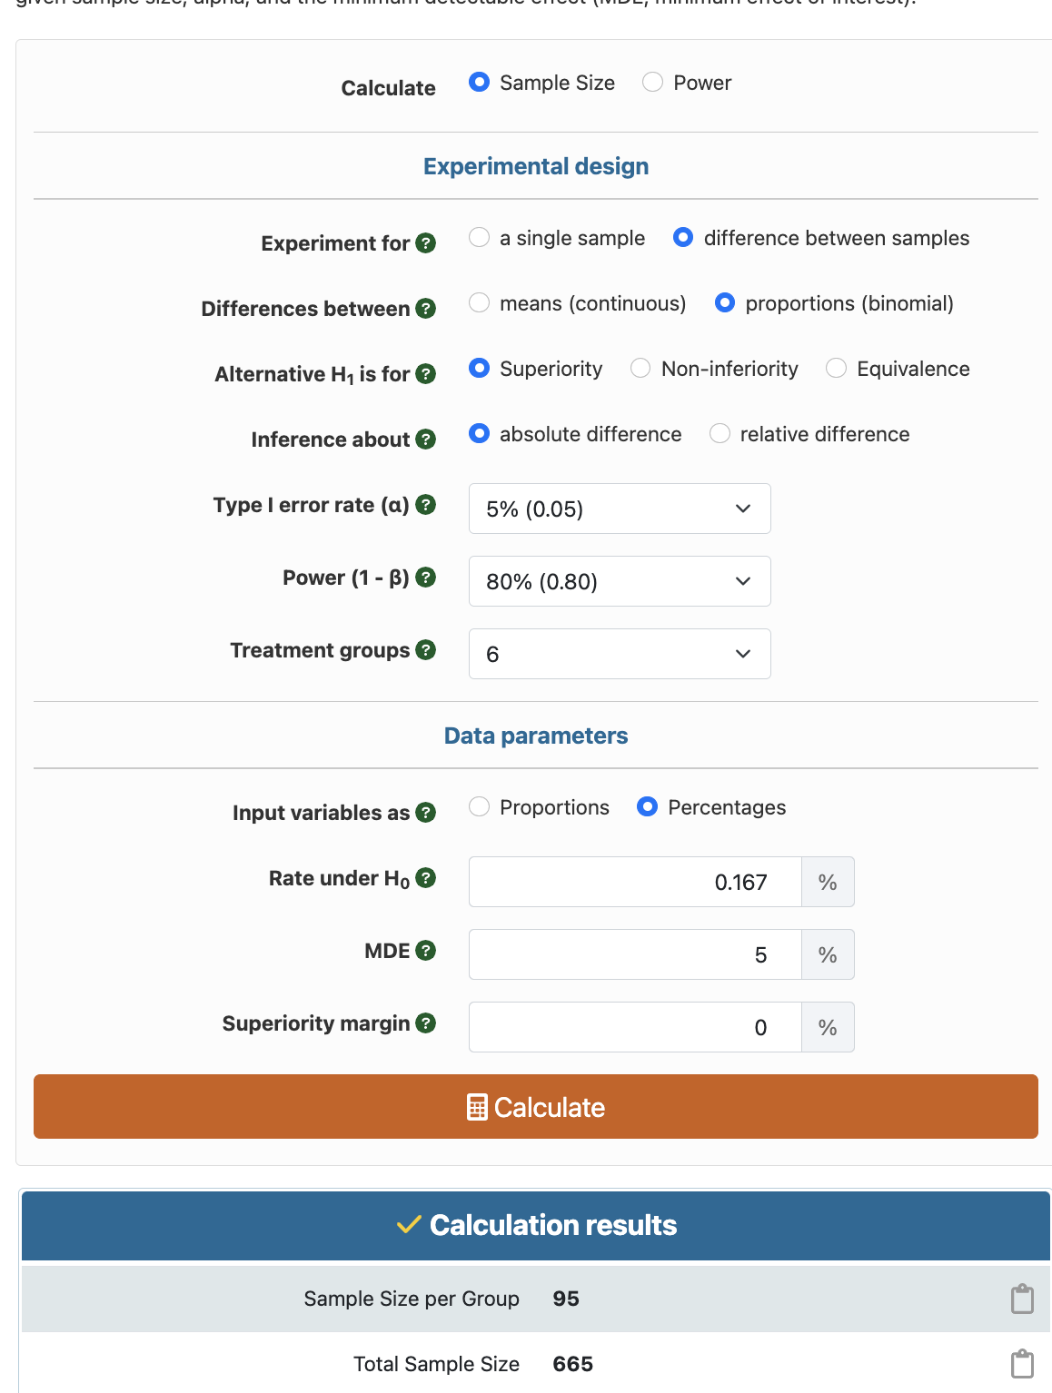
Power Analysis (Mixed Effect Model)
Alpha: 0.05
Power: 80%
Treatment Groups: 6 (angular velocities)
Rate under H₀: 1/6
MDE: 5 (for resolution of HRTF)
Results:
95 per angular velocity
Comes out to 16 participants needed

Slide 17
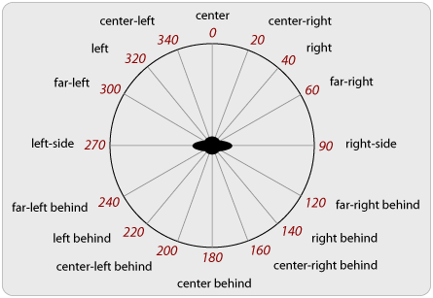
Data Collection
To collect onset/offset angles from the participant, we can have them listen to a stimulus sound at the experimental distance/speed and have them indicate on screen the starting and ending positions of the stimulus in the azimuth plane
Practice:
Participant will hear a sound moving who’s motion is represented on a GUI on the screen. The user will then enter the angles it started and stopped. The sound will move between 0 and 90 degrees at 10 degrees/sec and will play 250ms at the start and end to emphasize the position.
Training:
Participant will hear the sound in full, then indicate the starting and ending position on the GUI with feedback (with ~1 degree margin of error). The sound will move at 10 degrees/sec and will play 250ms at the start and end to emphasize the position.
Experiment:
Participant will hear the sound in full, then indicate the starting and ending position on the GUI without feedback (with ~1 degree margin of error). The sounds will play with combinations of the testing conditions

Slide 18
Data Collection
Mean difference from the expected
Difference between the onset/offset angle identified by the participant and the actual onset/offset angle of the sound source
Standard deviation of the MDFE
A moving 3-D sound is “reliable” if motion can be detected and it’s onset and offset angles can be perceived within 5° of the actual position

Slide 19
Data Collection
An HRTF screening will be given to fit an HRTF to the individual participant from the KEMAR dummy head HRTF database
We’ll use a clone of Armisha’s screening process

Slide 20
Data Analysis
H₀ is rejected, p ≤ 0.05
Paired t-test
Mean Difference from Expected + Standard Deviation
H₀ cannot be rejected, p ≥ 0.05
H₀ is rejected, p ≤ 0.05
Wilcoxon Signed Ranks Test
H₀ cannot be rejected, p ≥ 0.05
Notes:
If angular velocity is the variable for analysis in examining its effect on the difference between perceived and actual onset/offset angles, a paired t-test is appropriate. This will determine if the mean differences are statistically significant. If there are concerns regarding the normality of the data, a Wilcoxon signed ranks test can also be performed to reject/accept the null hypothesis. The Wilcoxon signed-rank test is a non-parametric test that compares the medians of paired data. It does not assume a specific distribution of the data, making it suitable for situations where the assumptions of the paired t-test are violated.

